Slide 1
AI Search (BFS DFS A*)
Jack McCoy
Sam Keener

Slide 2
(Teacher Mode)
2 Lessons - BFS and DFS one day, A* the next
EQs: What is Artificial Intelligence? How do computers make decisions?
Objectives:
Day 1: SWBAT emulate a BFS and DFS on a given data set and compare/contrast BFS and DFS.
Day 2: SWBAT emulate an A* search on a given data set and compare/contrast informed vs uninformed search.
Key Vocabulary - informed vs. uninformed, cost, heuristic, optimal
Extra Materials for extension/support: GeeksforGeeks article, videos

Slide 3
Day 1 - BFS vs DFS

Slide 4


Searching for Treasure
Hook: Looking for treasure in a cave system and analyzing the approach
What information would be valuable to have about each path?

Slide 5
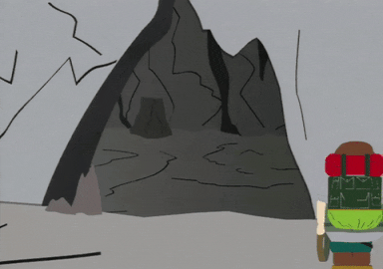

Efficiency Considerations - Cave Diving in Search of Treasure

Slide 6
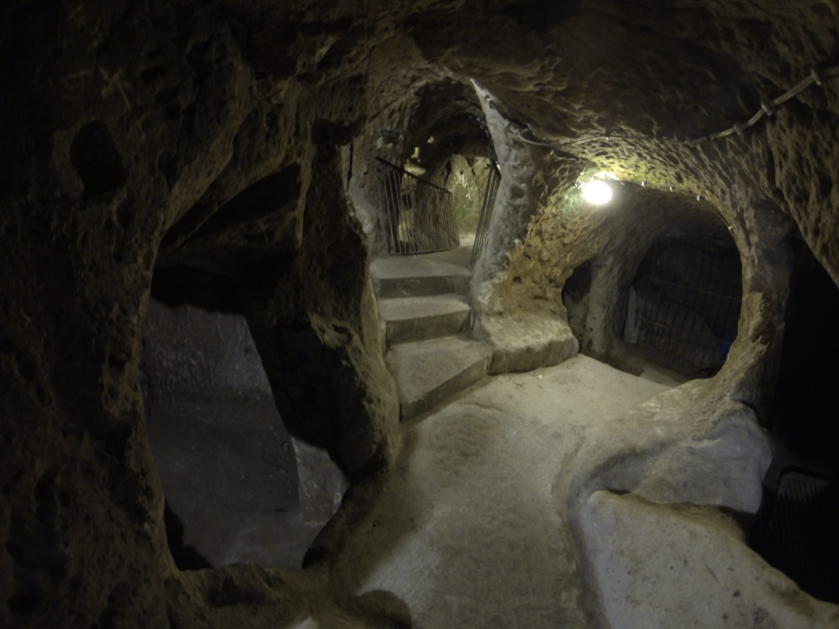
B
C
A

Slide 7
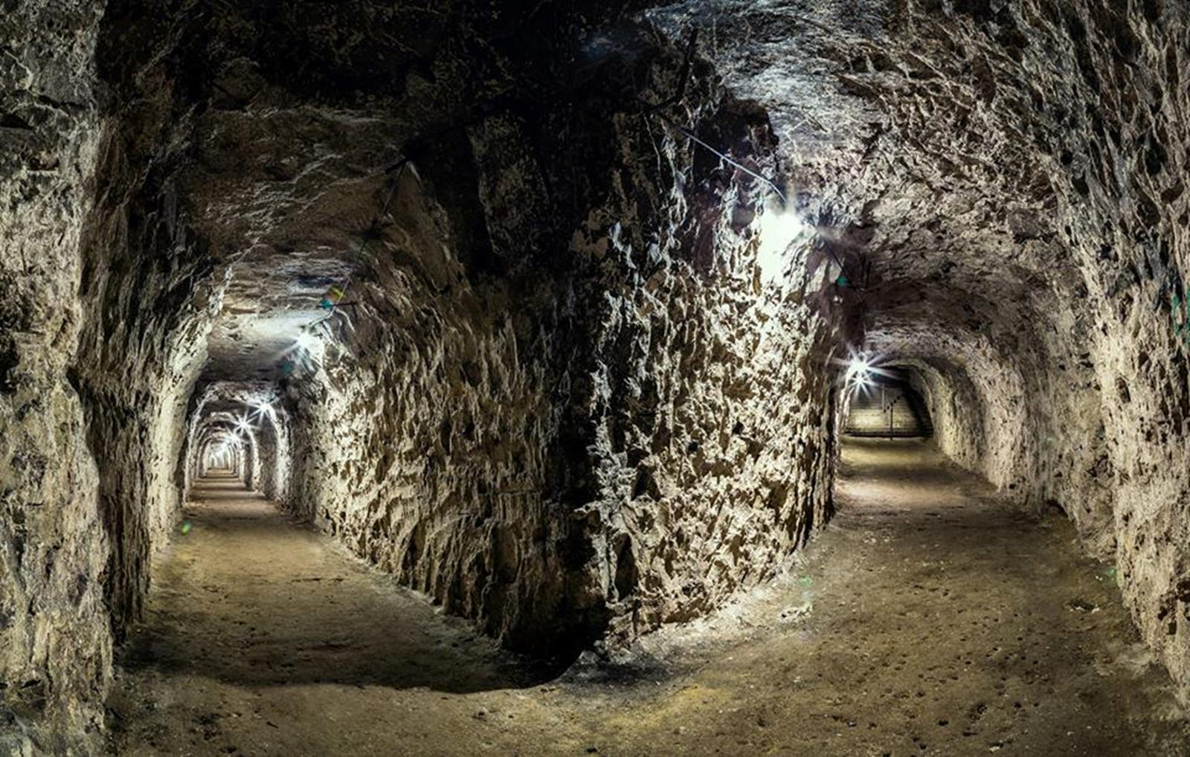
E
D

Slide 8
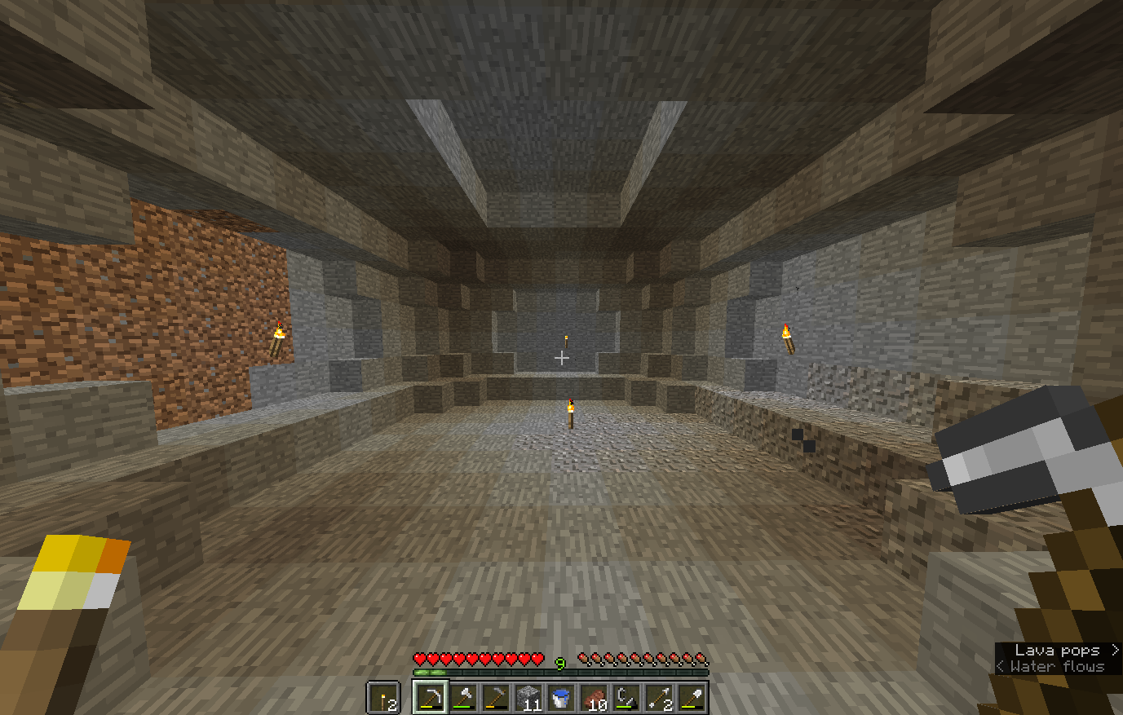
DEAD END

Slide 9
G
F

Slide 10
Strategies for Exploring and Mapping the Cave?
3 minutes → On a KtS, write down or diagram a strategy for exploring the cave.
2 minutes → Discuss your strategy with your partner.
1 minute → Adjust your strategies with input from your partner.
Notes:
[Elicit from the class]

Slide 11
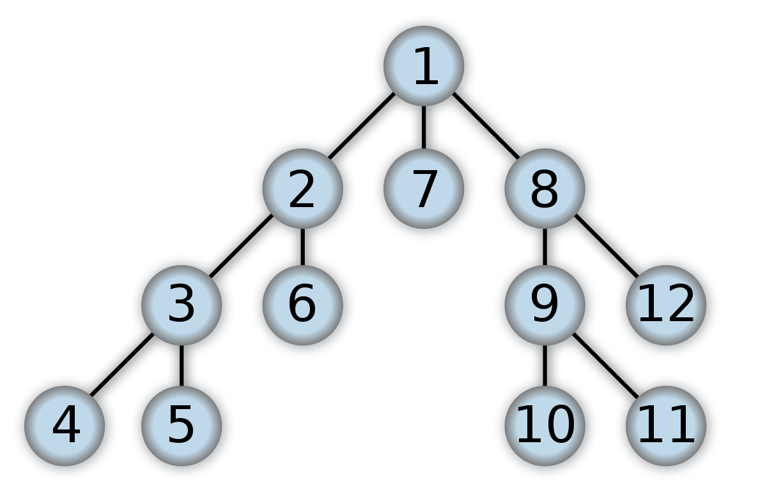
Map of the Cave

Slide 12
Exercise: Depth First Searching
Explore each branch IN ITS ENTIRETY before moving on to another.
DFS Rules:
From the starting node, GO LEFT!
Continue going left until you reach a dead end (there are no children).
Backtrack to the most recent path not chosen. Go down it and repeat steps 2-3.

Slide 13
DFS and Tree Traversal
(If you’ve taught Tree Traversal)
Which type of tree traversal does DFS most resemble:
pre-order?
in-order?
post-order?

Slide 14
How does this relate to Artificial Intelligence?
Decision Tree
Imagine each node is a chess move.
Do a Depth First Search to find a move, SOMEWHERE down the line, that results in checkmate.
Take that first move…
What issues might arise?

Slide 15
Find the Shortest Route
How do we know that the route we found to the treasure is the OPTIMAL route?
How could we find a shorter route to treasure?

Slide 16
Map of the Cave
Secret Tunnel!
Notes:
Talk about how decision trees are not always one-way, and sometimes can form webs or graphs, but can still operate like a tree.

Slide 17
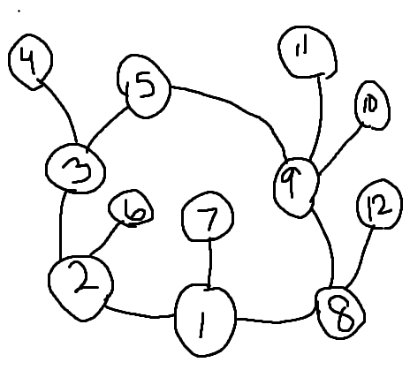
Non-tree Structure
Choose your next node arbitrarily.

Slide 18
Exercise: Breadth First Searching
Check each entire level of options before moving to the next.
BFS Rules:
Check every option that is 1 step away from the starting node from left to right.
Check every option that is 2 steps away from the starting node from left to right.
Check every option that is 3 steps… you get the idea...

Slide 19
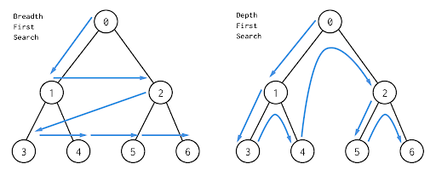

Slide 20
Day 1 - Coding Exercise
Subgoal Label the Depth First Search and anticipate/design any helper methods in the CaveMap class.
Extension: Code the Depth First Search in the CaveMap class. [Print the path]

Slide 21
Day 1 - Wrap Up Discussion Questions:
Describe the difference between BFS and DFS. Which one is better in your opinion, and why?
What is not ideal about both BFS and DFS?
Final Thought - reflect on for tomorrow:
Is there a way that we could have a more informed (intelligent) approach to searching? If so, what might we need in regard to the data tree?

Slide 22
Day 2 - A* Search

Slide 23
A* (A star) Search
Hook: Looking for treasure in a cave system, which path will you take with a radiation detector? [with cost path analysis]
A* Search: always analyzes path options with a heuristic and picks the route that is the best path forward with consideration of cost of each path (computing space, difficulty, physical distance, literal dollar cost, etc.)
Efficiency Considerations [Elicit from class - from previous day’s activity]
Informed vs Uninformed Searches
*Real world example(?) Google Flight Matrix - (decision making about Node - cities with cost path analysis)
Notes:
Efficiency Considerations- time, work involved

Slide 24
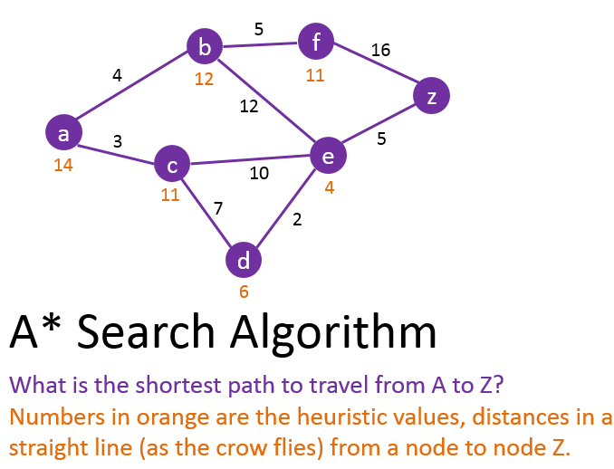

Slide 25
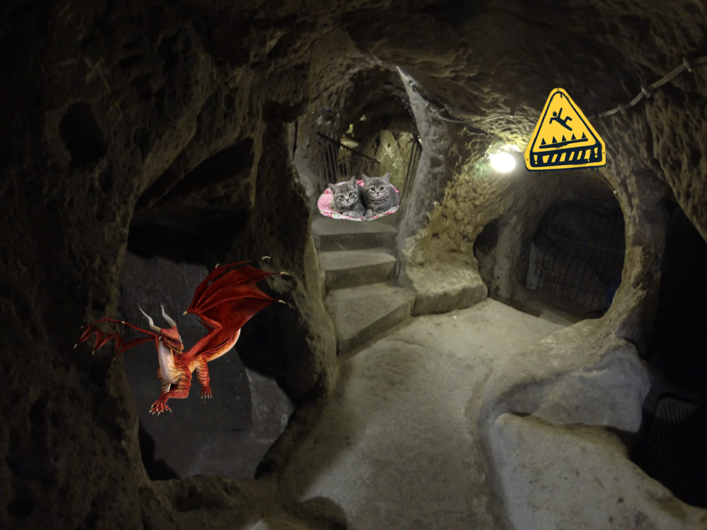

Slide 26
h = the node’s closeness to the goal(treasure)
g = the cost of traveling to that node
f = h + g
h = 12
g = 1
f = 13
h = 7
g = 3
f = 10
h = 3
g = 8
f = 11

Slide 27
g-values and h-values overview
The g-value is the actual cost of traveling from one node to another directly.
G stands for G-money, because it’s the cost.
The h-value is an estimate of the total cost to travel from that node to the goal node.
H stands for heuristic, a problem solving technique that involves approximating (by drawing pictures or quickly estimating)
H also stands for wHole cost from this node to the goal.
What should the h-value of the goal node be?
Admissible - an h-value is admissible (usable) only if it is less than or equal to the actual cost. Therefore, a heuristic can be seen as a MINIMUM total cost from one node to the goal.

Slide 28
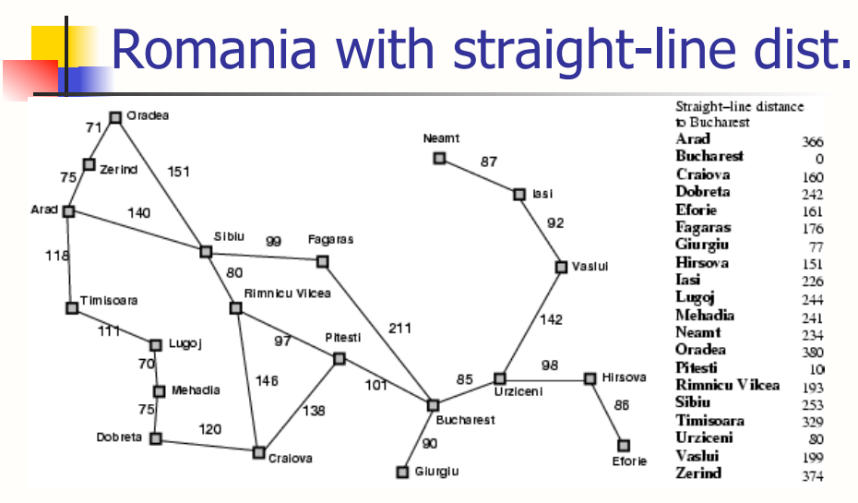
A* Search Basics
380
374
366
253
176
329
193
100
0
160
Notes:
Does using straight-line distance accurately measure how long a railroad track between two cities would be?
Important to understand that the heuristic MUST be less than or equal to the true cost!

Slide 29
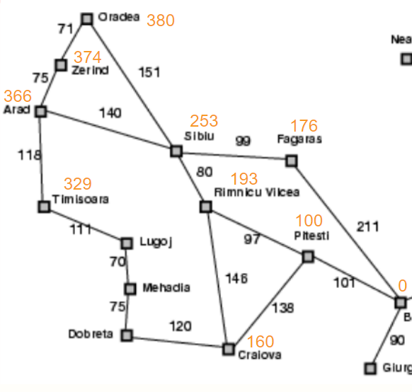
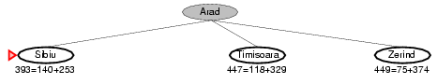
Even though Sibiu is farther away (higher g-value) than Timisoara and Zerind, it ultimately puts us much closer to Bucharest (h-value of 253). The sum of g and h is the lowest, so its minimum overall cost from Arad to Bucharest is lower than the others, and we will explore that first.

Slide 30
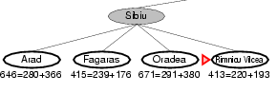
Cost so far = 140
We will choose to expand Rimnicu Vilcea because it has the lowest MINIMUM VALUE based on the heuristic!
Which other city might be a viable option?

Slide 31
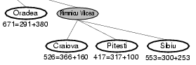
Which branch should we explore next?
Since the Arad-->Sibiu-->Fagaras route has an estimated total cost of 415, which is lower than all of the options available from Rimnicu Vilcea, we will look in that direction instead.

Slide 32
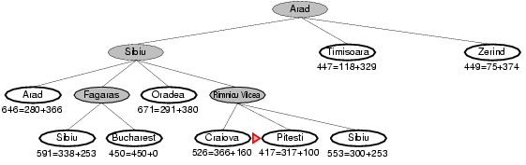
Are we done?
Although we made it to Bucharest, the total actual cost was 450, which may not be the lowest overall, as a previously explored branch has a minimum overall value of 417.
So let’s check that one, too!

Slide 33
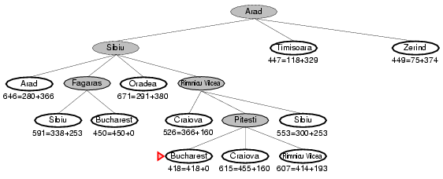
Are we done?
The total actual cost for the highlighted branch is 418. This is lower than the MINIMUM VALUES of all other possible branches to the solutions.

Slide 34
Day 2 - Coding Exercise
In your designated teams of 2:
Subgoal Label the A* Search in the Tree class.
Guiding Questions:
How will we keep track of the distance traveled?
How will we figure out the h-value of each node?
Extension: Write out pseudo-code for your A* Search with your partner.

Slide 35
Day 2 - Wrap Up Discussion Questions:
What is the difference between uninformed and informed search methods?
Why is A* generally so much more efficient than BFS or DFS?
What are some potential real world applications of the A* search?
Notes:
A* will check the least number of nodes and prove the best path (best of both worlds) [Worst Case - many paths that are very close to each other in cost, or if there are multiple paths that are equal in cost] - the worst case is breadth first, but it’s ceiling is way better
BFS will find the solution but it checks irrelevant nodes, [Worst case - goal node is at the end on the right hand side]
DFS just systematically follows a path, [Worst case - goal node is at the end on the right hand side]

